Slide 1

A PROJECT ON HUMAN RESOURCES ANALYTICS
By – Nandini Pola (18H61A05N3)
Neha Reddy (18311A05H7)
Pranavi Chitti (19315A0518)
Vamshi Balduri (18311A05Q7)

Slide 2
CONTENTS
Introduction – What is Human Resources Analytics?
Applications of Human Resource Analytics
Future for HRA
Steps we used in our project
Detailed step by step process
Final accuracy scores and confusion matrices
How our project will help the companies and conclusion

Slide 3
INTRODUCTION – What is Human Resources Analytics?
HR analytics is the process of collecting and analyzing Human Resource (HR) data in order to improve an organization’s workforce performance. The process can also be referred to as talent analytics, people analytics, or even workforce analytics.
This method of data analysis takes data that is routinely collected by HR and correlates it to HR and organizational objectives. Doing so provides measured evidence of how HR initiatives are contributing to the organization’s goals and strategies.
The existing system uses Support Vector Machine (SVM) one of the main issues with this is that it need the data to be linearly separable. The system also does not provide enough preprocessing and visualization or Exploratory Data Analysis(EDA).
We aim to build other classification models like logistic regression, Naïve Bayes, Decision Trees and others and also fine tune the parameters of the model. These models would be trained on a data set which will be engineered carefully after performing the feature engineering.

Slide 4
APPLICATIONS OF HUMAN RESOURCES ANALYTICS
Applicant Tracking & Assessment
Attracting Talent
Attrition Detection
Individual Skills Management/Performance Development

Slide 5
FUTURE FOR HUMAN RESOURCES ANALYTICS
Enterprise Management
Post-Hire Outcome Algorithms
Internal Management
Increased Behavior Tracking and Data-Based Decision Making

Slide 6
STEPS WE USED IN OUR PROJECT
These are the steps we followed in our project :
1. Performing pre-processing on the data:
Importing the libraries
Importing the data-set
Taking care of missing data
Encoding categorical data – i)Encoding the Independent Variable
ii)Encoding the Dependent Variable
Extracting Features & Labels
Splitting the data-set into the Training set and Test set
Feature Scaling
2. Applying algorithms and prediction
Applying the algorithms for Human Resources Analytics (Classification algorithms) – [We used Logistic Regression, Decision Tree and Random Forest]
Performing prediction and checking the accuracy of the model

Slide 7
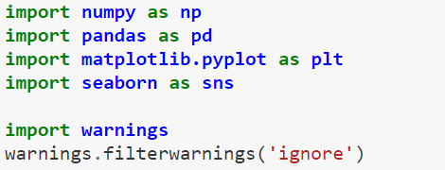
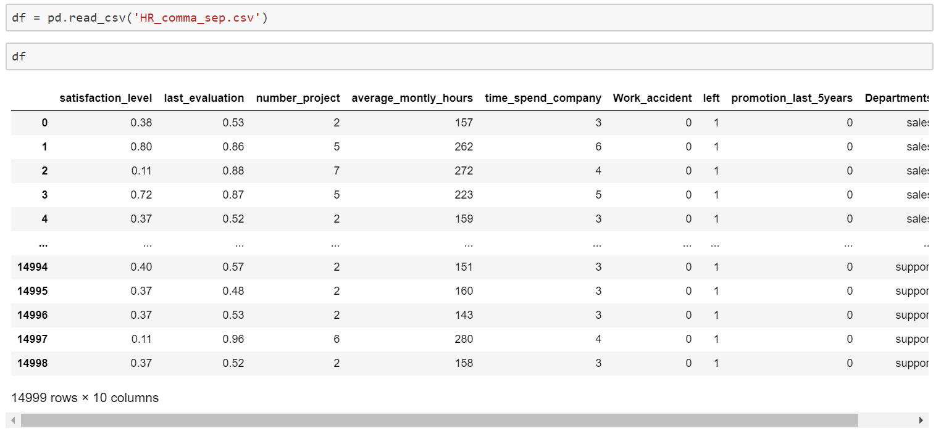
DETAILED STEP-BY-STEP PROCESS
Performing pre-processing on the data :
Importing the libraries :
Importing the dataset :

Slide 8
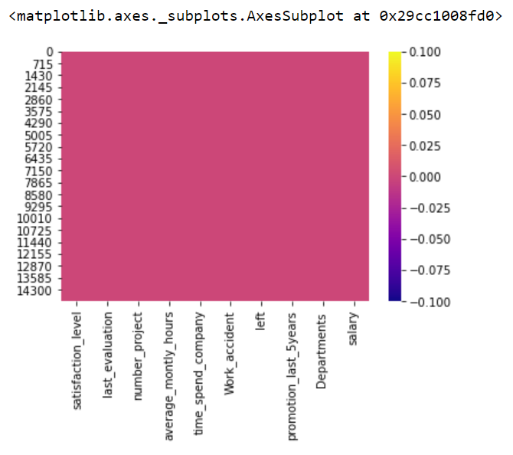
Checking for missing/null values in the dataset:
We can see that there are no missing values in the map.

Slide 9
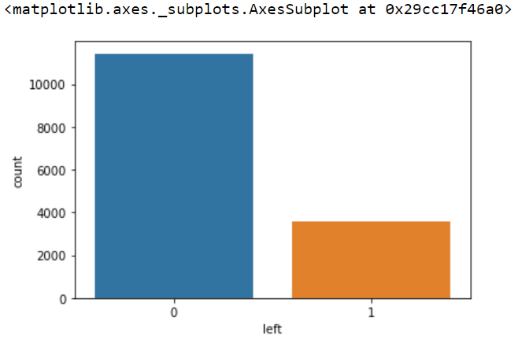
Now we are performing some data analysis on the dataset by using visual representation through graphs for better understanding of the problem in the dataset.
The column "left" is the target of this dataset. Hence, we are creating a visual representation of how many employees left the company and how many stayed.¶
→
“1” indicates the number of employees that left and “0” indicates the number of employees who stayed in the company.

Slide 10
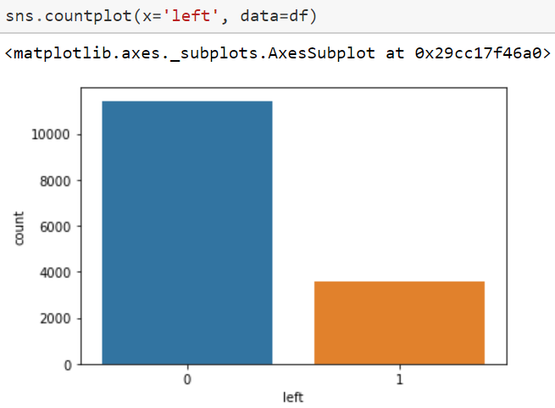
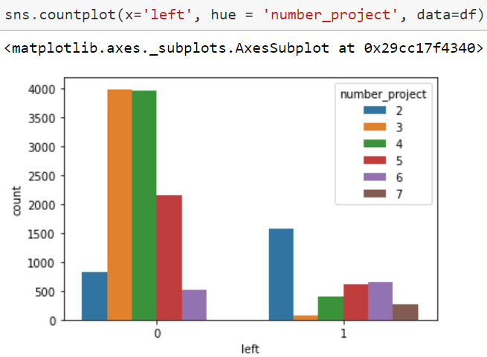
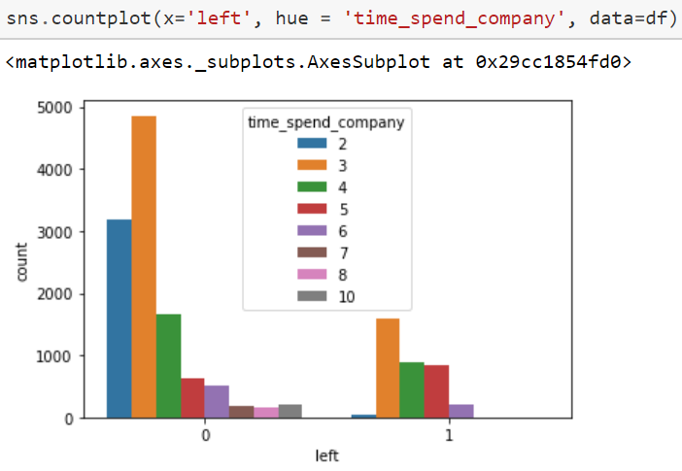
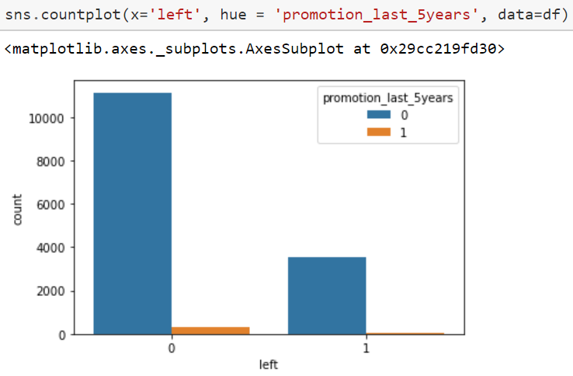
Now let's see the significance of different features on the employees that left and didn't leave.¶

Slide 11
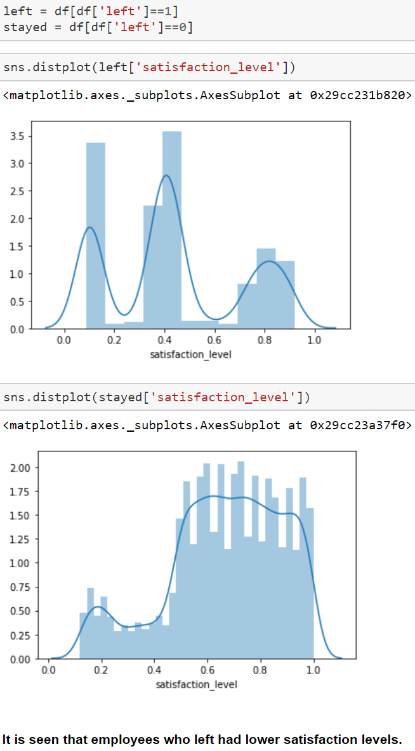
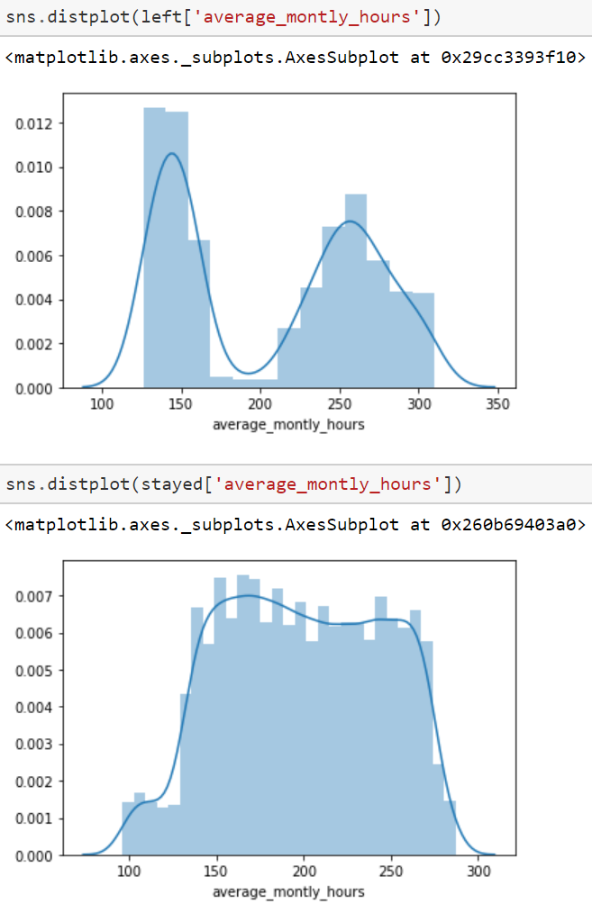
From the previous slide, we can see that employees whose salaries were low and medium and those who did not receive a promotion in the last 5 years had left the company.

Slide 12
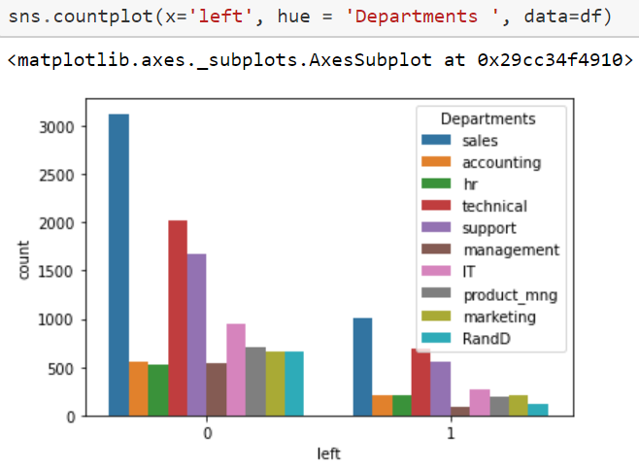
The following graph shows that most of the employees who left were from the departments sales, technical and support respectively.

Slide 13
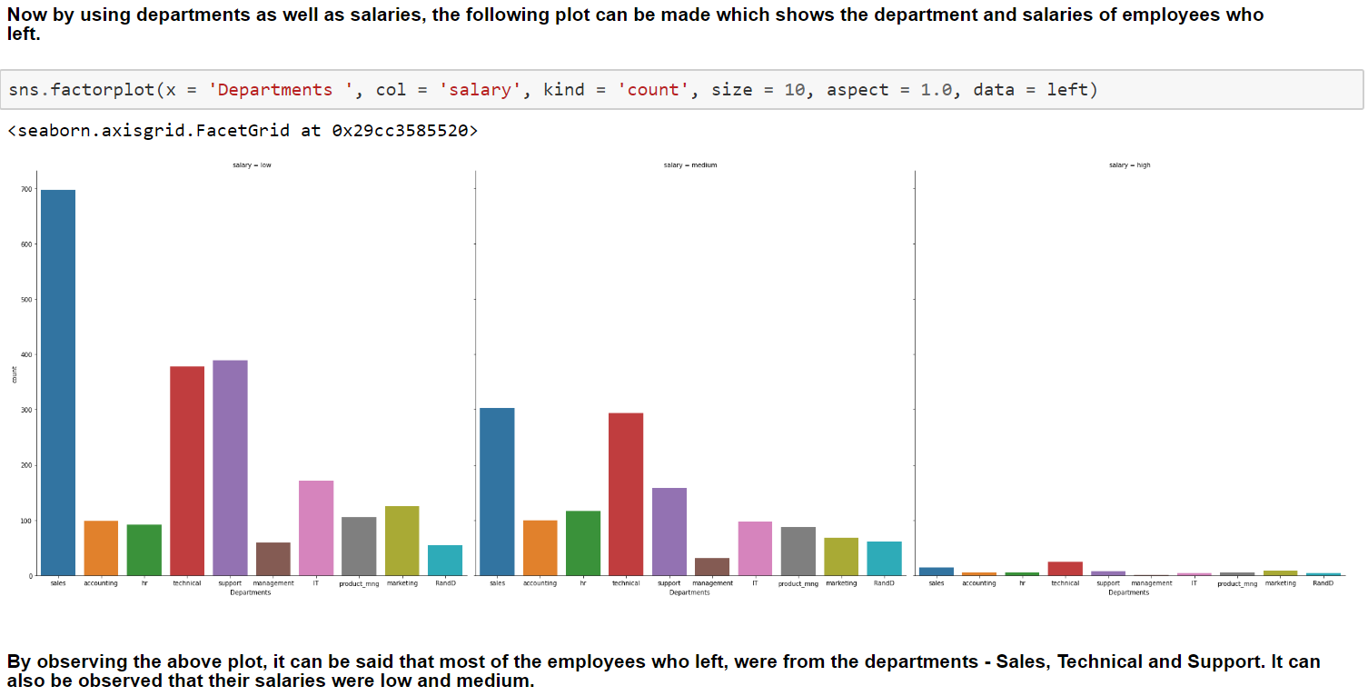

Slide 14
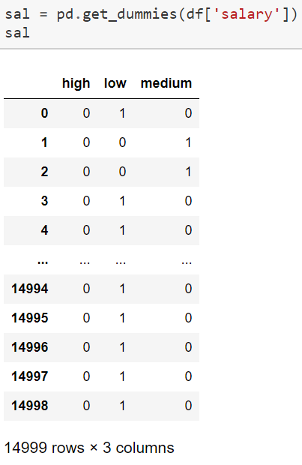
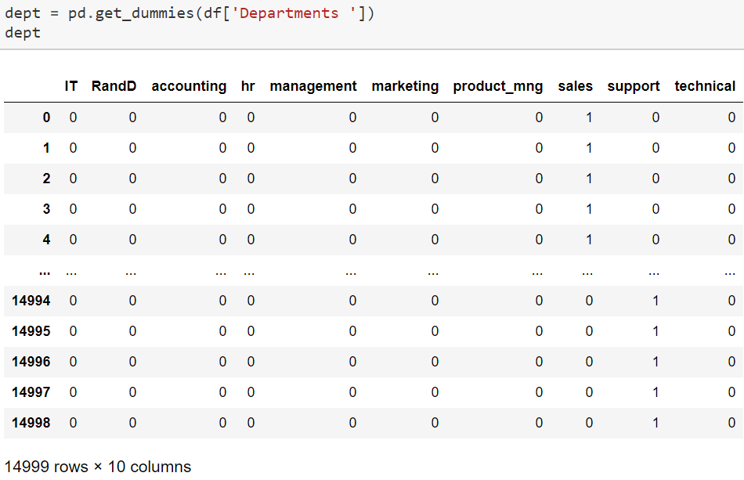
Now that we have checked for missing data and performed data analysis, next step is encoding the categorical data, in our case it is the salary and departments columns (we are doing it using get_dummies method).

Slide 15
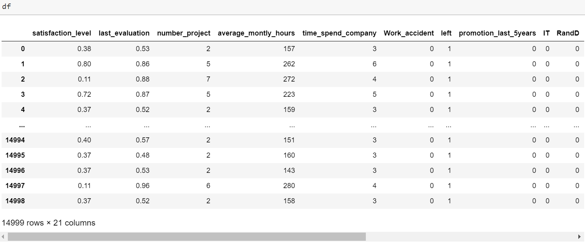
After encoding, we must concatenate it to the dataset and delete the old categorical data.
You can see in the dataset above that the number of columns increased to 21.

Slide 16
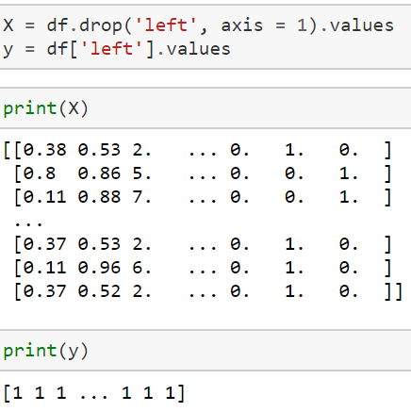
Next step is to extract the features and labels.
Now we must split the dataset into training and test sets. This can be done as shown below --

Slide 17

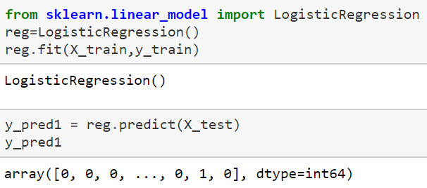
LOGISTIC REGRESSION
After splitting the data, we are applying different algorithms to the dataset and at last we will check which one has the highest accuracy. First one is logistic regression.
What is logistic regression? → Logistic regression is a supervised learning classification algorithm used to predict the probability of a target variable. The nature of target or dependent variable is dichotomous, which means there would be only two possible classes. In simple words, the dependent variable is binary in nature having data coded as either 1 (stands for success/yes) or 0 (stands for failure/no). Mathematically, a logistic regression model predicts P(Y=1) as a function of X. It is one of the simplest ML algorithms that can be used for various classification problems such as spam detection, Diabetes prediction, cancer detection etc.
The code we used for performing the algorithm is shown on the left.

Slide 18
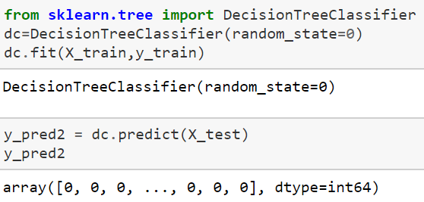
DECISION TREE CLASSIFIER
What is decision tree classifier? → Decision Trees are a type of Supervised Machine Learning (that is you explain what the input is and what the corresponding output is in the training data) where the data is continuously split according to a certain parameter. The tree can be explained by two entities, namely decision nodes and leaves. The leaves are the decisions or the final outcomes. And the decision nodes are where the data is split.
The code we used for performing the algorithm is shown on the left.

Slide 19

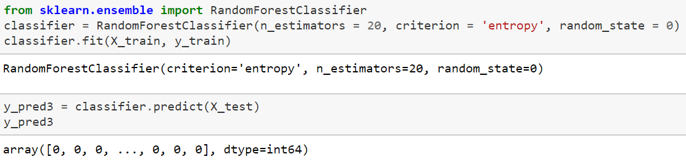
RANDOM FOREST CLASSIFIER
What is random forest classifier? → Random forest classifier creates a set of decision trees from randomly selected subset of training set. It then aggregates the votes from different decision trees to decide the final class of the test object.
The code we used for performing the algorithm is shown on the left.

Slide 20
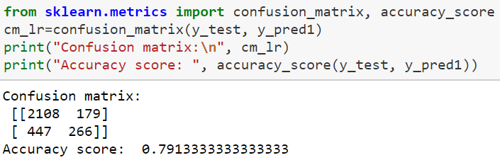
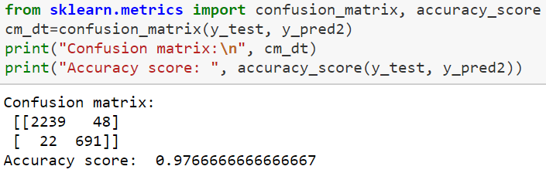
ACCURACY SCORES AND CONFUSION MATRICES
Score and confusion matrix of logistic regression algorithm
Score and confusion matrix of decision tree classifier

Slide 21
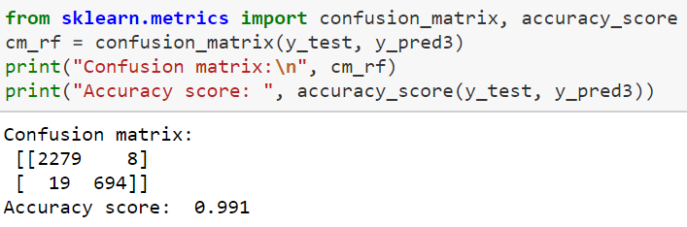
Score and confusion matrix of random forest classifier
As you can see above, the random forest classifier has the highest accuracy score in all the three algorithms with an accuracy score of 99.1% as compared to 79.1% of logistic regression and 97.66% of decision tree algorithm.

Slide 22
CONCLUSION
Our project can help by processing the huge amounts of HR data in most of the companies, and help them understand why certain employees are leaving, what is the cause factor, and help them improve themselves in that particular department.
Human Resources Analytics can play a huge role in companies by giving them the right tools to analyze their data. Being able to flag which employees are at risk enables organizations to step in with preventative measures and avoid the cost of losing productivity and the cost of re-hiring.
We can use the algorithms given previously and perform analysis on the data to reduce the overall cost of hiring again.

